Slide 1
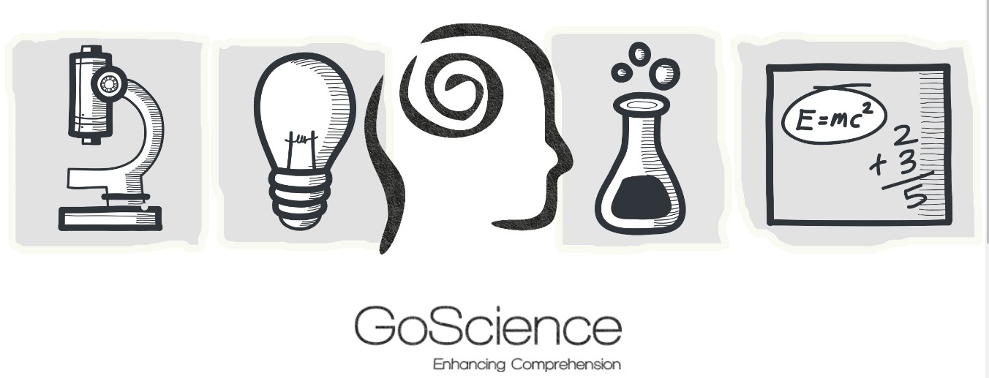
Erasmus+ project
“GoScience – creativity and enhanced comprehension in science teaching and learning”
(2017-1-BG01-KA201-036209)
E6: GoScience Multiplier Event
2 July 2019 – Iasi, Romania
This project has been funded with support from the European Commission.
This publication reflects the views only of the author, and the Commission cannot be held responsible for any use which may be made of the information contained therein.

Slide 2
Project partnership
5 partners from 4 European countries:
Zinev Art Technologies Ltd. (Bulgaria)
Latvian Adult Education Association (LAEA) (Lettonia)
Riga State Technical School (Lettonia)
Fundația EuroEd (Romania)
Associació Empresarial l’Alqueria Projectes Educatius (Spagna)

Slide 3
The project’s main idea
Develop an innovative method of teaching and learning science by enhancing students’ comprehension through creative pedagogical tools.

Slide 4
Specific aims of the project
Implementation of student centered pedagogical approach that stimulates their creativity and their active role in their own learning process, increasing comprehension of science subjects.
Training teachers how to work with the pedagogical approach which will enable them to control the scientific relevance of knowledge taught and learnt and to motivate students to work alone and take responsibility for their own education.
Support students at risk (of early school leaving, low achievements, students with migrant backgrounds, young people outside the education system) to learn better, achieve better results at school and most importantly learn difficult subjects as science subjects in an easy and motivating way.

Slide 5
Enhancing students’ comprehension
Make connections —students develop the ability to connect the new topic or information to previous knowledge they have about the world.
Ask questions —students ask themselves (or others) questions about the new information in order to clarify points, get more knowledge they think it is necessary to get the whole picture of the concept.
Visualize —students make a visual mental representation of what they have read about.
Identify the structure and the main components of the information —students distinguish the essentials in the text; distinguish between fact and opinion;
Make inferences —students use what they know to guess about what they do not know; they use their prior knowledge and current information to draw conclusions, make critical judgments, etc.
Determine cause-and-effect relationships; compare and contrast ideas or information; analyse problems and find solutions; identify and name the steps in a process; summarize.
Synthesize —students combine new information with current knowledge to form original ideas, new lines of thinking, or new creations.

Slide 6
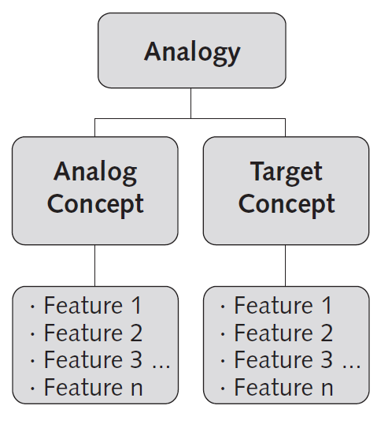
The project’s principles
Integration of arts learning approaches into STEM education
Focus on the development of students’ creative skills
Use of analogies

Slide 7
Integration of arts learning approaches into STEM education (1)
Integration of arts learning approaches into STEM education has been a popular topic lately. Most arguments supporting this idea state that the arts and humanities can provide students with investigational and interpretive tools enhancing their understanding of diverse concepts and phenomena.
The arts and humanities also equip students with the creative and critical thinking skills they need to know in a complex changing society

Slide 8
Integration of arts learning approaches into STEM education (2)
The Goscience method relies on techniques which are commonly used in humanities – story telling, theatre performances, dances, graphics, videos etc.
Science and art naturally overlap.
Science and arts are both tools investigating our world and involving the development of ideas, theories, and hypotheses. The arts and sciences are products of human creativity. Art has long been recognized as an important part of a well-rounded education.
Through their emotional side the arts tap into many different interests and abilities and forms of learning, which will lead to students getting a deeper understanding of the new concepts.

Slide 9
The project’s outputs:
Database of creative pedagogical tools (videos, models, short theatre performances, stories told).
A starter kit (manual) for teachers of physics, chemistry, biology, and mathematics, which will include:
Formulation/definition of the theoretical themes (concepts and relations) of the subjects in the curriculum.
At least one pedagogical tool of each theme, to be used as a comprehension model of the theoretical concept (i.e.: a video of a short theatre performance arts), a story, or another tool teachers and students create.

Slide 10
1. Cercetări privind abordările pedagogice creative axate pe îmbunătățirea înțelegerii în predarea și învățarea științelor în școală
Cuprins
CAPITOLUL 1: Înțelegerea și alfabetizarea în contextul învățării științifice .....................................3
CAPITOLUL 2: Importanța vocabularului în educația științifică .....................................................23
CAPITOLUL 3: Îmbunătățirea înțelegerii lecturii unui text științific ...............................................34
CAPITOLUL 4: Îmbunătățirea înțelegerii ascultării în educația științifică.......................................58
CHAPTER 5: Îmbunătățirea înțelegerii în educația în domeniul disciplinelor de științe prin
utilizarea analogiilor vizuale...........................................................................................................70
CAPITOLUL 6: Predarea reciprocă pentru îmbunătățirea înțelegerii în educația științifică...........79
CAPITOLUL 7: Integrarea artei în predarea și învățarea științelor.................................................89
CAPITOLUL 8: Gândire inversă pentru îmbunătățirea înțelegerii în științe..................................103
CAPITOLUL 9: Abordarea holistică a predării și învățării științelor...................................111
Disponibil in limba romana la http://www.goscience.eu/download/Project%20results/1/ro.pdf

Slide 11
2. Ghid pentru profesori - îmbunătățirea creativității și a înțelegerii în predarea și învățarea disciplinelor științifice
Cuprins
Conținutul metodologiei
Prezentare generală
1. Cadrul metodologic pentru creșterea înțelegerii în educația științifică
1.1. Necesitatea coerenței conținutului educațional cu modelul de înțelegere a studenților
1.2. Definirea înțelgerii
1.3. Tipuri de înțelegere
1.3.1. Înțelegerea citirii
1.3.2. Înțelegerea ascultării
1.4. Niveluri de înțelegere și de creativitate
1.4.1. Niveluri de înțelegere la citire
1.4.2. Niveluri de înțelegere în ascultare
1.4.3. Niveluri ale creativității
2. ABORDĂRI PENTRU ÎMBUNĂTĂȚIREA ÎNȚELEGERII
2.1. Utilizarea analogiilor și metaforelor
2.2. Utilizarea modelelor
2.3. Folosirea ilustrației, a explicațiilor și a colocvialismului
2.4. Folosirea artei și a dramei
2.5. Utilizarea hărților concept de știință
3. Instrumente și resurse pedagogice pentru creșterea înțelegerii
3.1. Construirea unor analogii eficiente
3.2. Dezvoltarea modelului
3.3. Jocuri și instalații de artă
3.4. Construirea hărților concept de știință
Note adiționale
Disponibil in limba romana la http://www.goscience.eu/download/Project%20results/2/ro.pdf

Slide 12
3. Development of creative pedagogical tools for enhancing comprehension in science teaching and learning
The pedagogical tools which will be created to support the developed approach and methodology will interpret theoretical science concepts by expressing them through familiar phenomena and natural, conventional relation which the student will be able to perceive intuitively through an associative image, video, or a fiction story.
Electrical circuit
https://www.youtube.com/watch?v=hJn5vGHHQEA
Math functions
https://www.youtube.com/watch?v=9pNWXsDl7T0

Slide 13
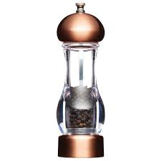
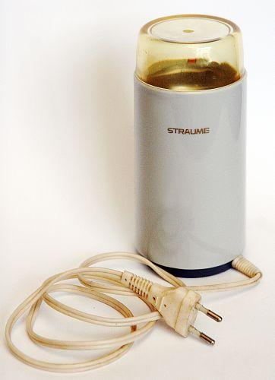
3. Development of creative pedagogical tools for enhancing comprehension in science teaching and learning
Analogous organs

Slide 14
3. Development of creative pedagogical tools for enhancing comprehension in science teaching and learning
Term - «Analogous organs»
Definition Organs that perform similar functions but are of different origins are analogous organs. (https://www.siic.lu.lv/bio/IT/B_10/default.aspx@tabid=9&id=172.html). Organs of animals or plants that perform similar functions bur are of different origins and constructions. (https://lv.oxforddictionaries.com/skaidrojums). | Visual associations | Descriptions of associations in words Electric coffe-mill and a hand operated grinder consists of different parts.But both gadgets are used for grinding/coffe or pepper/It means they perform a similar functions.The same as analogous organs.

Slide 15
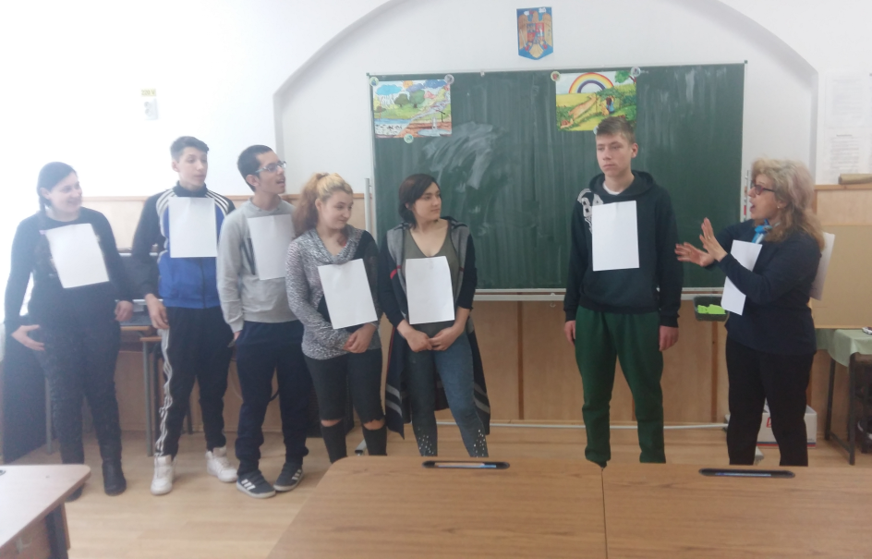
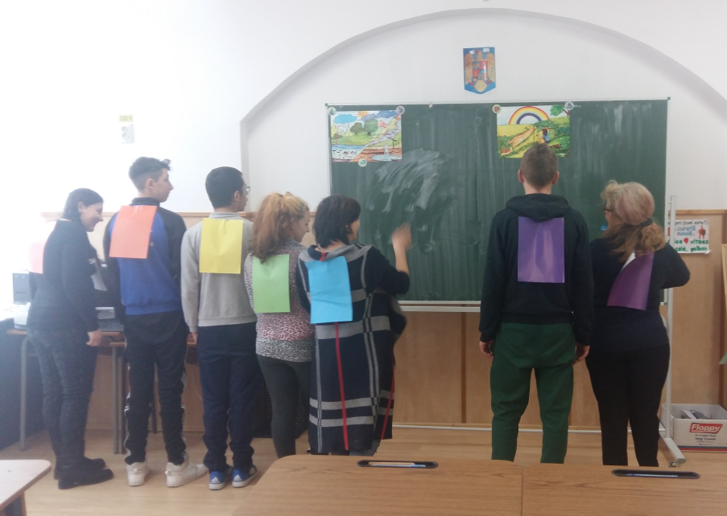
3. Exemple de bune practici în învăţarea fizicii la elevii cu C.E.S.
Dispersia luminii – dramatizare “Povestea razei de lumină”

Slide 16
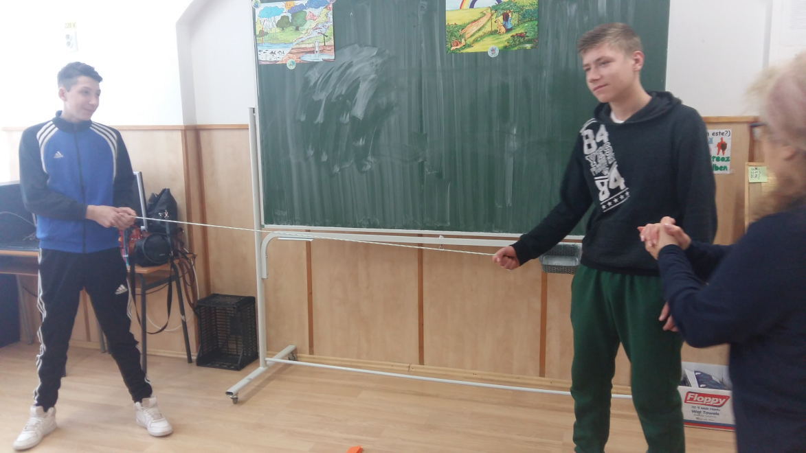
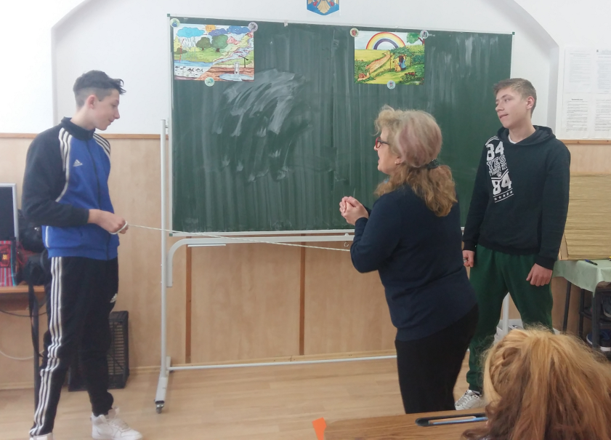
3. Exemple de bune practici în învăţarea fizicii la elevii cu C.E.S.
Principiile mecanicii newtoniene- joc

Slide 17
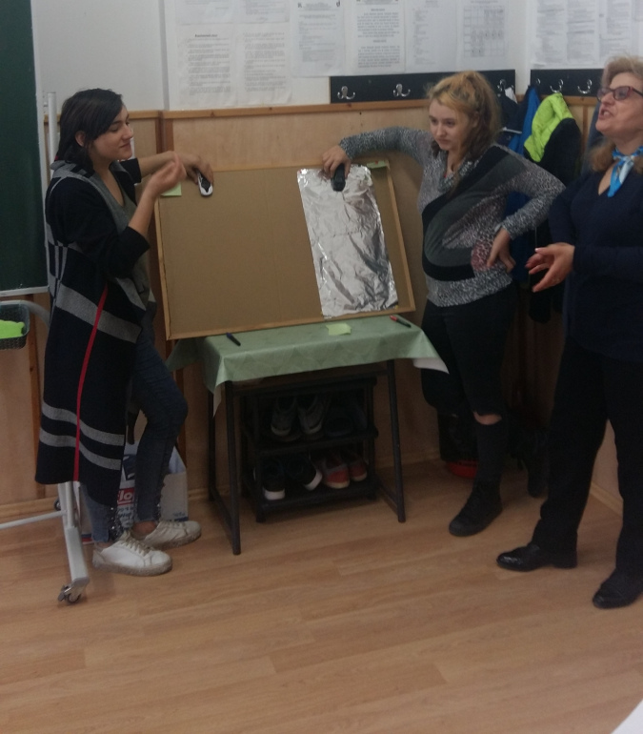
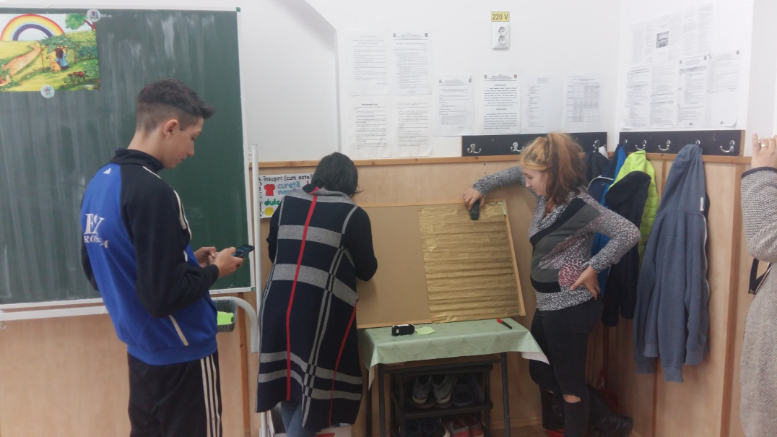
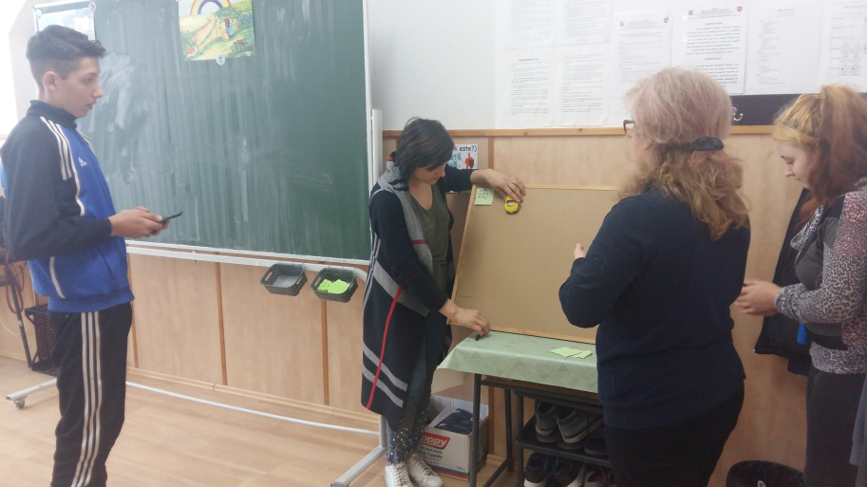
3. Exemple de bune practici în învăţarea fizicii la elevii cu C.E.S.
Forţa de frecare - experiment

Slide 18
Conclusions
Given the role that science and technology has in our society and students’ lack of interest in these school subjects the European project GoScience has embarked on stimulating students’ motivation to study science by using innovative means.
The project’s innovative method enhances students’ comprehension through creative pedagogical tools commonly used in humanities – story telling, theatre performances, dances, graphics or videos.
The project’s activities and tools increase students’ creativity, which makes scientific knowledge better understandable and thus increases the probability of implementing it in real life (increased functional literacy for students). The materials also stimulate students’ creativity and critical thinking skills and their active role in their own learning process, increasing their comprehension of science subjects.
The project’s activities and tools also support students at risk (of early school leaving, low achievements, students from migrant backgrounds, young people outside the education system) to learn better, achieve better results at school and, most importantly, learn difficult subjects such as science subjects in an easy and motivating way.

Slide 19
THANK YOU!
Fundatia EuroEd: www.euroed.ro
Contact:
Professor Dr. Anca Colibaba: acolib@euroed.ro
Project manager, Andreea Ionel: andreea.cleminte@euroed.ro
Project website: http://www.goscience.eu

